Slide 1
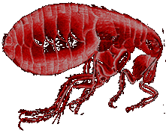

The Black Death of the Middle Ages
The Bubonic Plague
Lesson 11-6
Horrible Histories – Perilous Plague 25 m
DS Video – The Bubonic Plague 7m
Activity Worksheet – Symptoms of the Plague

Slide 2
TN SPI
  6.5.12 Recognize the possible causes of change in civilizations (diseases Bubonic Plague)
  6.5.8 Identify conclusions about early world historical events using primary and secondary sources

Slide 3
Overcrowding and Disease
Medieval towns and cities were extremely crowded.
The lack of sanitation and procedures for keeping the town clean, was a breeding ground of disease.
One disease, the Bubonic Plague, wiped out one-third of Europe’s population between 1347 and 1351. (4 years)

Slide 4
The Plague Arrives
Historians think that the plague arrived in Europe from trade ships arriving in the Mediterranean.
Mongolian warriors spread the disease through battles. Catapulting dead bodies over walled cities. (Genghis Khan)
Few villages escaped. Churchyards were full with bodies. Up to 200 buried on a daily basis.
The plague spread quickly during the winter of 1348-1349 to the north of England. By 1350, nearly all of Britain was infected with the plague.
At the end of 1350 nearly two and a half million people were dead!

Slide 5
What did people think caused the plague?
There were many different beliefs about the plague; people were so scared because they weren’t sure what caused it. Some believed:
  It was a punishment from God.
  Some believed that foreigners or those who followed a different religion had poisoned the wells.
  Some thought that bad air was responsible.
  Some thought the position of the planets had caused the plague.

Slide 6
What Really Caused the Plague?
The question that you are probably thinking is this:
Q: Who or what really caused the Black Death?
A: The Oriental Rat Flea!

Slide 7
How was the plague transmitted?
We now know that the most common form of the Black Death was the BUBONIC PLAGUE!
This disease was spread by fleas which lived on the black rat.
The fleas sucked the rat’s blood which contained the plague germs.
When the rat died, the fleas jumped on to humans and passed on the deadly disease.

Slide 8
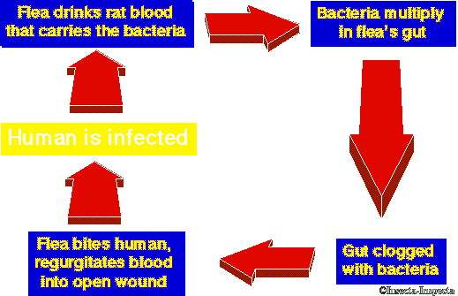

Slide 9
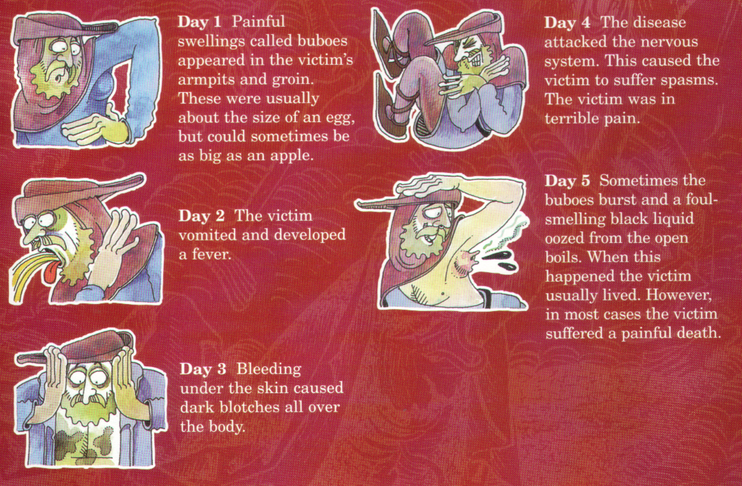
Buboes – swollen lumps in the groin,
Neck, or armpit
What are the symptoms of the plague?

Slide 10
What is the prognosis?
A person suffering from the Bubonic Plague most likely would die within 4 to 7 days of first showing symptoms.
The plague killed 50% to 75% of its victims.

Slide 11
Cures?
Different beliefs about the plague led to some strange attempts at escaping the plague and some even stranger cures.

Slide 12
Medieval Cure #1
The swellings should be softened with figs and cooked onions. The onions should be mixed with yeast and butter. Then open the swellings with a knife.
If the swellings burst and the poison came out people sometimes survived. It seemed sensible to draw out the poison.

Slide 13
Medieval Cure #2
Take a live frog and put its belly on the plague sore. The frog will swell up and burst. Keep doing this with further frogs until they stop bursting.

Slide 14
Other Medieval Cures
Rub the body with melted butter.
Tie a small bag of garlic around your neck. The smell would keep the plague away.
Go to church and ask for forgiveness.
Avoid breathing in the same air as a plague victim.
Sit next to a blazing hot fire.
Brick or board up houses with the sick inside.

Slide 15
Two Types
The Pneumonic Plague, became a killer when the infection reached the lungs.
Because it destroyed the breathing system, this plague could be caught if someone breathed on you.
Bubonic Plague did not affect the victim’s lungs, but caused large swellings as the body fought the disease.
To catch this type of plague you had to be bitten by a flea that had already bitten a black rat.

Slide 16
So did the cures work?
The last outbreak of the plague in England was in 1665. The sensible thing to do when the plague struck was to get out of town, the rich could do this but the poor had nowhere to go.
By 1665, more than 25 million people had died from the plague.

Slide 17
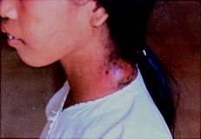
Can I get the plague today?
The Bubonic Plague did not go away. It still exists, everywhere in the world. It is quite common among rodent populations – rats of course, but squirrels, rabbits and skunks as well.
We have a cure for it, but it is a fast moving illness and sometimes not recognized fast enough.

